Slide 1
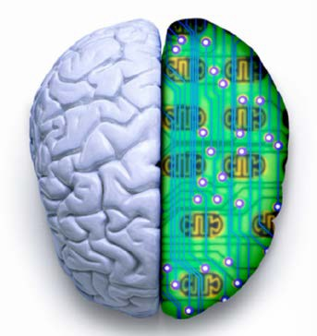
Advanced Artificial Intelligence CM4107 (Week 1)
Lecture 1: Introduction to Artificial Intelligence
Professor Nirmalie Wiratunga

Slide 2

What is AI?
AI, broadly (and somewhat circularly) defined, is concerned with intelligent behaviour in artefacts –
Nils J. Nilsson, Stanford
AI is defined as the theory and development of computer systems able to perform tasks that normally require human intelligence, such as visual perception, speech recognition, decision-making, and translation between languages.

Slide 3
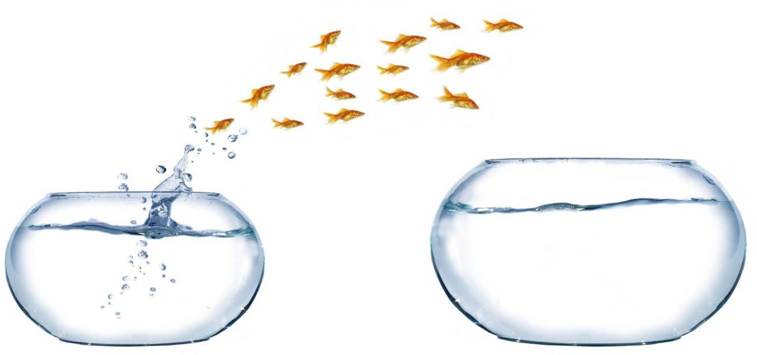
... the hottest topic out there at the moment …
AI is everywhere (Google, Facebook, Uber, Amazon, …)

Slide 4
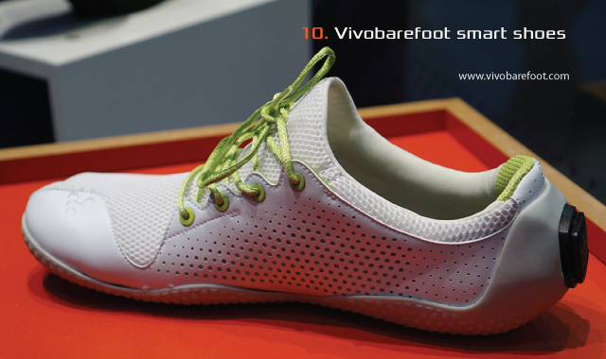
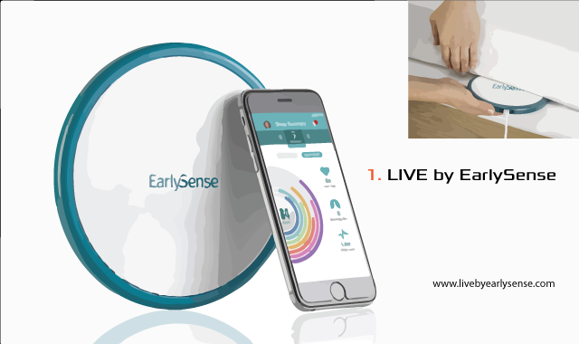
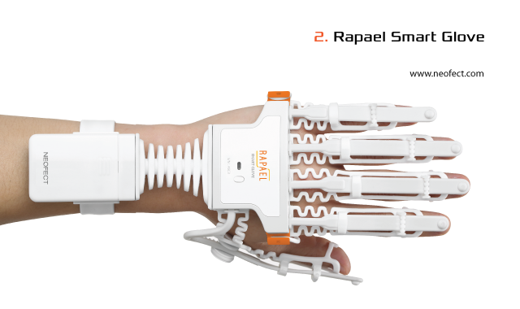
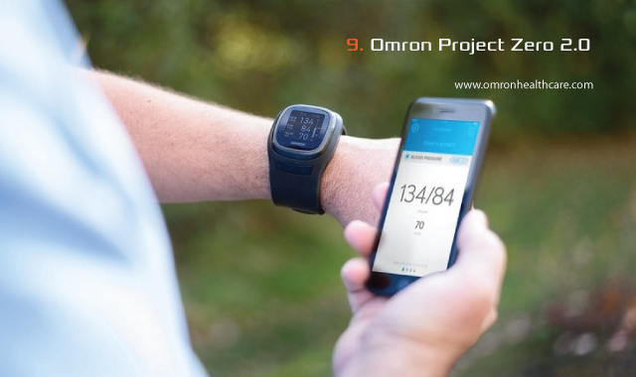
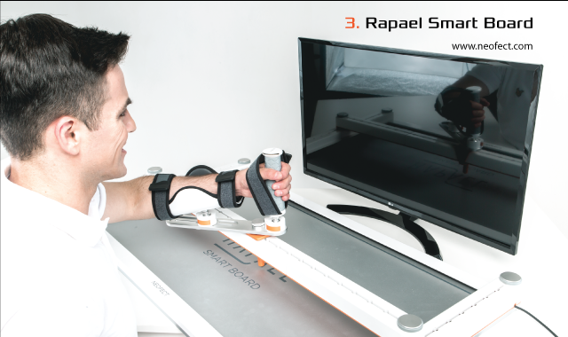

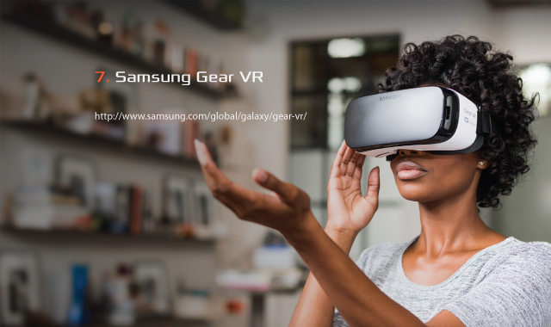
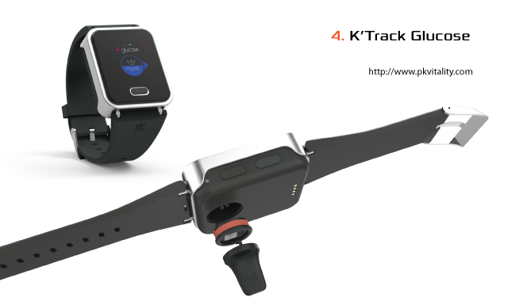
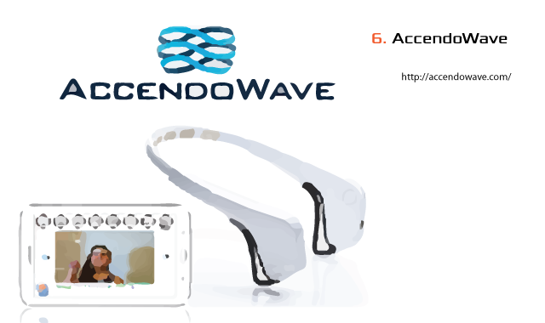
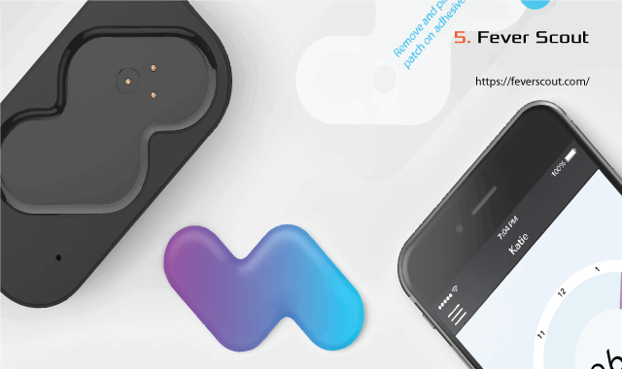
AI in Health and wellbeing
Healthcare
Wearables
in the market
Notes:
The LIVE by EarlySense is a remote monitoring device that monitors sleep and vital statistics for bedridden patients. The piezoelectric sensor disk plugs into an outlet and slides under a patient’s mattress. Real time patient vitals can be monitored through a mobile application, which can be supervised by caregivers and clinicians. The device, which was only available in hospitals, was made available to consumers in January 2017. Clinical studies found that the device is 92.5% accurate when detecting sleep patterns, heart rate, breathing, movement, and other potential stressors. A monthly subscription is required to monitor the device.
The Rapael Smart Glove has an exoskeletal design that assists people who have had strokes, and other patients with neurological and musculoskeletal injuries regain mobility in their hands. Using a Bluetooth sensor, the glove measures the patient’s motion through a 30-minute exercise, and creates an exercise schedule based on the patient’s needs. The glove includes game software allowing patients to simulate playing ping pong, chopping food and catching a baseball, rewarding points to encourage engagement.
A version of the Rapael Smart Glove has been available in hospitals since 2014, but a new home edition is now available for patients who need help with mobility. The glove is available to patients to rent for $99 and is reimbursable through many health plans.
Another new product from Neofect, the Rapael Smart Board assists patients with shoulder and elbow mobility. Using game-based technology, the device creates exercises based on a patient’s ability and performance.
The device includes a board with a hand grip, and allows patients to increase conditional exploration, point-to-point reaching, and shape drawing through exercise. The real-time assessment of patient data includes range, speed, smoothness and harmony of motion. The Smart Board will be available for clinical use in April 2017.
Painless and accurate glucose monitoring has been the goal of many health technology companies. The watch-like K’Track Glucose monitor aims to be the solution for people with type 1 and type 2 diabetes by using technology that uses micro needles to collect and analyze fluid right below the skin surface. The needles are less than 0.5 mm. The micro needles are a part of a replaceable cartridge that lasts 30 days, but can take unlimited readings in the time period.
Users push a button on the device to check their glucose levels, and it takes a minute for results to display on the face of the device. Results of the day can also be displayed on the device, and all results over time are synced to a mobile app. The device will be available to purchase later this year.
AccendoWave has partnered with Samsung to create a new concept in pain management—distraction. Users can wear any headband and/or ear buds (pictured above with InteraXon), and AccendoWave measures discomfort in the user's electroencephalography (EEG) system.
The device connects to a Samsung tablet, which generates content based on the user’s discomfort level. The content ranges from games, music and short videos, to longer clips and movies provided by DirectTV. The user’s pain level is continuously monitored through their brain waves, and users are prompted to rate the content and how it alleviates their pain.
During a six-month trial at a hospital system, 90% of users said they enjoyed using the AccendoWave, 81% said it helped them feel more comfortable, and 77% said it understood their discomfort. The pain distraction technology is currently being tested in other health systems across the country.
Samsung head
The Ava bracelet is an FDA-approved medical device that monitors a woman’s fertility and menstrual cycle. The device contains sensors that collect up to 3 million data points that correlate with the rise of reproductive hormones. These parameters include resting pulse rate, skin temperature, sleep, perfusion, bioimpedance, breathing and sleep.
The combination of the data points can predict 5.3 fertility dates within a woman’s cycle with 89% accuracy, according to clinical studies. Users only wear the device at night, and the data syncs with a mobile application. Ava’s creators hope that the device will take the place of ovulation strips and BBT thermometers that women currently use to track ovulation. The Ava bracelet has been on sale in the United States since 2015, and the company hopes to expand to Europe in early 2017.
The Omron Project Zero 2.0 is a watch-like device that promises to measure blood pressure, sleep and other physical activities with clinical accuracy. A prototype of the device was unveiled at the 2017 Consumer Electronics Show.
The device syncs with a mobile application, and has a rechargeable battery that last up to week, according to the manufacturer. Kellogg says that the device is currently being evaluated for FDA clearance.
Billed as a fitness shoe with a built-in computer, the Vivobarefoot will track vital signs of runners with hopes to reduce injury in the future. The shoe monitors real time speed, pace, cadence, foot landing, time on the ground, impact, asymmetry and toe engagement. The shoe’s creators hope to use this data for business and academic purposes to make running and walking more safe and efficient.
The shoe is being created through a partnership with Sensoria, a fitness garment company, and Vivobareboot, a running shoe company.
Two removable cores embedded in a thin 5 mm outsole connect to four pressure points in the foot. An accompanying mobile app houses all the data tracked during a run. The shoe is slated to be available to purchase later this year.

Slide 5

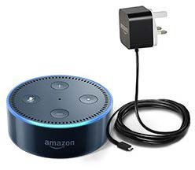
AI in Commerce
Amazon alexa
AI enabled by the internet involves commerce, especially electronic commerce and the use of software agents of various sorts to provide, search for, analyse or interpret information.

Slide 6
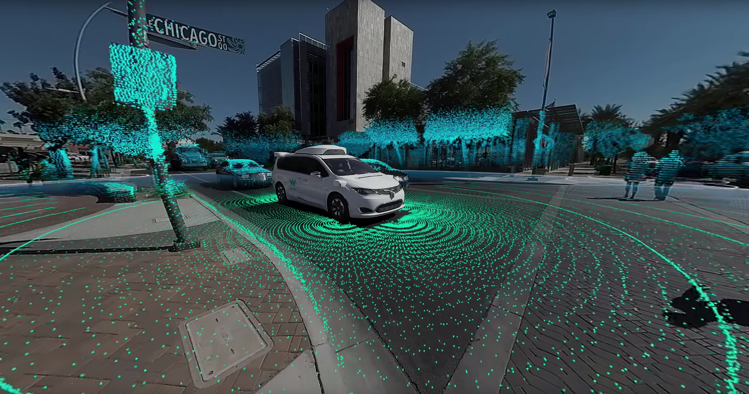
AI and Self-Driven Cars
vehicles have sensors and software that are designed to detect pedestrians, cyclists, vehicles, road work and more from up to three football fields away in all 360 degrees.
Notes:
Waymo began as the Google self-driving car project in 2009. Today, we're an independent self-driving technology company with a mission to make it safe and easy for everyone to get around—without the need for anyone in the driver’s seat
How Google Waymo vehicles work:
The driver (or passenger) sets a destination. The car's software calculates a route.
A rotating, roof-mounted Lidar sensor monitors a 60-meter range around the car and creates a dynamic 3D map of the car's current environment.
A sensor on the left rear wheel monitors sideways movement to detect the car's position relative to the 3D map.
Radar systems in the front and rear bumpers calculate distances to obstacles.
AI software in the car is connected to all the sensors and collects input from Google Street View and video cameras inside the car.
The AI simulates human perceptual and decision-making processes and controls actions in driver-control systems such as steering and brakes.
The car's software consults Google Maps for advance notice of things like landmarks and traffic signs and lights.
An override function is available to allow a human to take control of the vehicle.

Slide 7
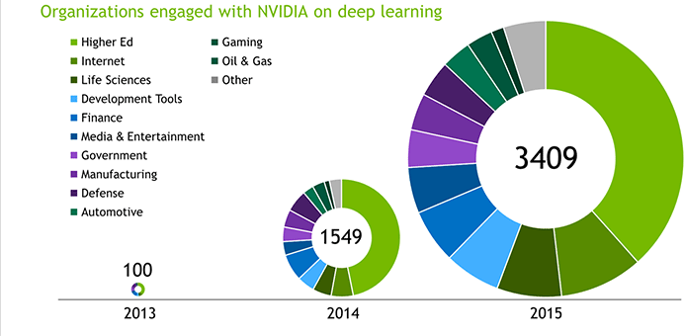
Companies want Intelligence
(image courtesy of Nvidia)

Slide 8
Introduction
Artificial Intelligence is a field that has a long history
but is still actively growing.
An important topic of computer science
Simulation of different cognitive aspects
Problem Solving: Understanding, Reasoning, Learning
expand and augment (not replace) human capability.
Numerous applications and huge possibilities in AI!

Slide 9
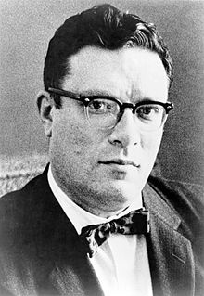
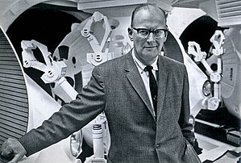
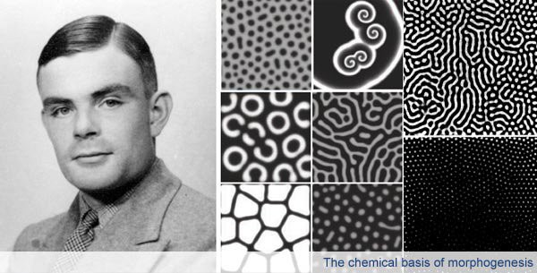
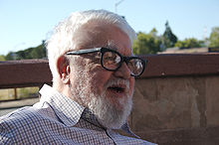
The Beginnings
Science fiction
1942, Isaac Asimov publishes the three laws of robotics. A robot may not injure a human being or, through inaction, allow a human being to come to harm. A robot must obey orders given it by human beings except where such orders would conflict with the First Law. A robot must protect its own existence as long as such protection does not conflict with the First or Second Law.
Also the “2001 space Odyssey” by Sir Arthur C. Clark
AI as a field
- 1950, Alan Turing (Cambridge) publishes the Turing Test, a means of determining if a machine can think
- 1956, The term Artificial Intelligence is coined at a meeting at Dartmouth College
- Arguably the seminal event for artificial intelligence as a field
Organised by John McCarthy (MIT, Stanford)
- Invented Lisp in the late 1950s
Notes:
Greek myths of Hephaestus and Pygmalion incorporate the idea of intelligent robots. Many other myths in antiquity involve human-like artifacts. Many mechanical toys and models were actually constructed, e.g., by Hero, Daedalus and other real persons
Claude Shannon published detailed analysis of chess playing as search (1950).
Law Zero: A robot may not injure humanity, or, through inaction, allow humanity to come to harm. Law One: A robot may not injure a human being, or, through inaction, allow a human being to come to harm, unless this would violate a higher order law. Law Two: A robot must obey orders given it by human beings, except where such orders would conflict with a higher order law. Law Three: A robot must protect its own existence as long as such protection does not conflict with a higher order law.

Slide 10
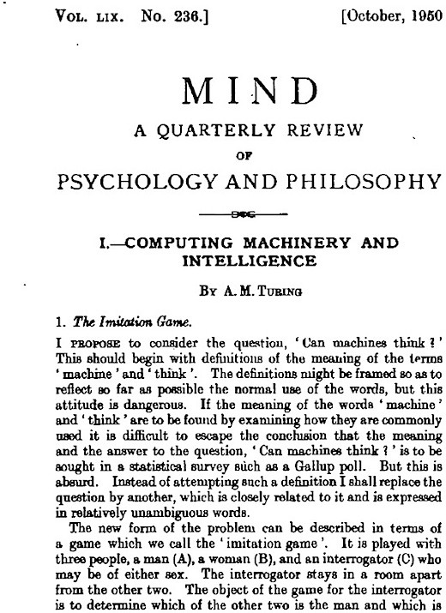
Modern History of AI
A.M. Turing published "Computing Machinery and Intelligence" (1950). - Introduction of Turing Test as a way of operationalizing
a test of intelligent behavior.

Slide 11
The Turing Test
Uses the "Imitation Game"
Usual method
Three people play (man, woman, and interrogator)
Interrogator determines which of the other two is a woman by asking questions
Example: How long is your hair?
Questions and responses are typewritten or repeated by an intermediary
Turing Test
Machine takes the part of the man
Notes:
Wants to answer the question "Can machines think?
Machine – a digital computer (discrete-state machine)
After Turing laid out the Turing Test in his original paper, Turing goes over a list of “Contrary Views on the Main Question”:
Machines:
can’t make mistakes
can’t be creative
can’t learn
can’t do other than what they’re told
etc

Slide 12
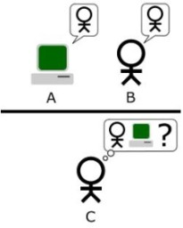
The Turing Test
The Turing test determines a machine's ability to exhibit intelligent behavior equivalent or indistinguishable from that of a human.
http://www.singularitysymposium.com/turing-test.html
Notes:
The mere knowledge that we are dealing with a machine will bias our judgment as to whether that machine can think or not, as we may bring certain preconceptions about machines to the table.
Moreover, knowing that we are dealing with a machine will most likely lead us to raise the bar for intelligence: it can’t write a sonnet? Ha, I knew it!
By shielding the interrogator from the interrogated, such a bias and bar-raising is eliminated in the Turing-Test.

Slide 13
The Turing Test
1950: The Turing Test was developed by Alan Turing
Turing proposed a test consisting of a human evaluator
Paper: Computing Machinery And Intelligence: Stop debating what intelligence means
Designed to evaluate the intelligence of a computer
In the test, there is a person who asks questions and either another person or a computer program responds.
The computer passes the test if the “asking” person cannot distinguish whether the answers or the conversation comes from the computer or the person.
Humans don’t behave rationally
The reverse engineering is very hard to do

Slide 14
Strength of the Test
"The new problem has the advantage of drawing a fairly sharp line between the physical and the intellectual capacities of a man" (Turing, 1950)
Requires: natural language processing, knowledge representation, automated reasoning and machine learning.
Does not capture the ability to manipulate objects and move about.
Notes:
http://www.loebner.net/Prizef/TuringArticle.html
Requires success in 6 disciplines of AI which compose most of AI
* natural language processing – enables it to communicate successfully with the interrogator
* knowledge representation – to store what it knows or hears
* automated reasoning – to use the stored information to answer questions and to draw new conclusions
* machine learning to adapt to new circumstances and to detect and extrapolate patterns
Total Turing Test – to test perceptual abilities and examine objects
*computer vision – to perceive objects
* robotics – to manipulate object and move about

Slide 15
What does it mean if a computer passes the Turing Test?
Can the computer think?
Does the computer have a mind in exactly the same sense that you and I have minds?

Slide 16
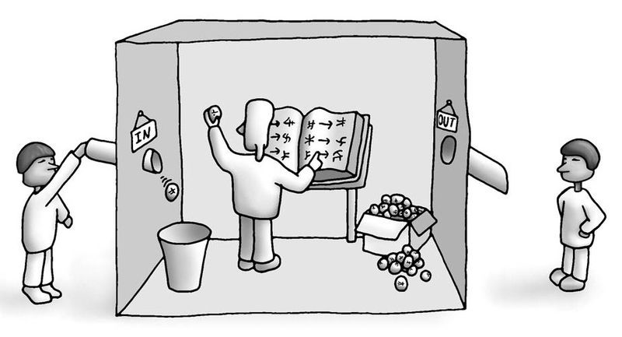
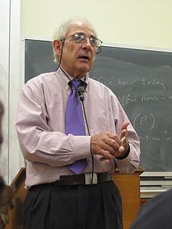
Chinese Room
Thought experiment purposed by John Searle in 1980
Given that we have constructed a machine that behaves as though is understands Chinese, it convinces a Chinese speaker that it speaks Chinese
John Searle
Given Chinese symbols, it consults a look-up table and produces other Chinese symbols as output

Slide 17
Chinese Room substitution
Machine is replaced by Searle sitting in a room where he receives Chinese symbols, looks them up on a look-up table, and returns the Chinese symbol indicated by the table
English speaker can now give correct answers to Chinese questions without understanding Chinese
Since Searle doesn't understand Chinese, how can it be said that the computer understands Chinese?

Slide 18
Systems Reply
Although Searle himself doesn't understand Chinese, it is reasonable to say that Searle plus look-up table understand Chinese
Counter example: he memorized the look-up table before entering the room

Slide 19
Robot Reply
The reason that we don't want to attribute understanding to the room, or a computer is that the system doesn't interact properly with the environment
Solution: put the computer in a robot so that it can interact with the world
Reply: Cognition is not symbol manipulation. Second, Searle could be inside the robot and still not understand Chinese

Slide 20
Chinese Room Conclusion
The mind is not a computer
Thus the Turing Test is inadequate
Notes:
If a system does not interact properly with its environment it cannot be said to think or understand
Searle concerned about intentionality (mental content)– computer cannot have intention
the mind has mental contents which enable mental states to refer to or be about objects and states of affairs in the world. Where language is concerned this is semantic content
Confusion about the meaning to intelligence
Biological intelligence: dog is more intelligent than a mouse
Metaphorical intelligence: apply the concept of intelligence to things that have no mental life at all

Slide 21
How would you show that a machine can think? In other words what tests might you propose to confirm human-level of artificial intelligence?
Notes:
Some examples
The Turing Test (Turing)A machine and a human both converse sight unseen with a second human, who must evaluate which of the two is the machine, which passes the test if it can fool the evaluator a significant fraction of the time. Note: Turing does not prescribe what should qualify as intelligence, only that knowing that it is a machine should not disqualify it.
The Coffee Test (Wozniak)A machine is required to enter an average American home and figure out how to make coffee: find the coffee machine, find the coffee, add water, find a mug, and brew the coffee by pushing the proper buttons.The
Robot College Student Test (Goertzel)A machine enrolls in a university, taking and passing the same classes that humans would, and obtaining a degree.
The Employment Test (Nilsson)A machine works an economically important job, performing at least as well as humans in the same job.
The flat pack furniture test (Tony Severyns)A machine is required to unpack and assemble an item of flat-packed furniture. It has to read the instructions and assemble the item as described, correctly installing all fixtures.

Slide 22
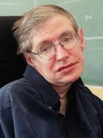
Is AI an existential threat?
Prof Stephen Hawking, one of Britain's pre-eminent scientists, has said that efforts to create thinking machines pose a threat to our very existence.
Article appeared on BBC https://www.bbc.co.uk/news/technology-30290540
8 January 1942 – 14 March 2018

Slide 23
Ethical Issues of AI
Explainable AI: the need to explain the reasoning and proposed actions by an AI system. Not merely a “black box”.
Unemployment: The hierarchy of labour is concerned primarily with automation. Self-driving trucks seem like an ethical choice.
Wealth Inequality: a company can drastically cut down on relying on the human workforce. Consequently, individuals who have ownership in AI-driven companies will make all the money.
Humanity &behaviour: While humans are limited in the attention and kindness that they can expend on another person, artificial bots can channel virtually unlimited resources into building relationships encouraging addictive behaviours.
Security: The more powerful a technology becomes, the more can it be used for nefarious reasons as well as good. AI systems that can cause damage if used maliciously.
Notes:
1. Unemployment. What happens after the end of jobs?
The hierarchy of labour is concerned primarily with automation. As we’ve invented ways to automate jobs, we could create room for people to assume more complex roles, moving from the physical work that dominated the pre-industrial globe to the cognitive labour that characterizes strategic and administrative work in our globalized society.
Look at trucking: it currently employs millions of individuals in the United States alone. What will happen to them if the self-driving trucks promised by Tesla’s Elon Musk become widely available in the next decade? But on the other hand, if we consider the lower risk of accidents, self-driving trucks seem like an ethical choice. The same scenario could happen to office workers, as well as to the majority of the workforce in developed countries.
2. Inequality. How do we distribute the wealth created by machines?
Our economic system is based on compensation for contribution to the economy, often assessed using an hourly wage. The majority of companies are still dependent on hourly work when it comes to products and services. But by using artificial intelligence, a company can drastically cut down on relying on the human workforce, and this means that revenues will go to fewer people. Consequently, individuals who have ownership in AI-driven companies will make all the money.
We are already seeing a widening wealth gap, where start-up founders take home a large portion of the economic surplus they create. In 2014, roughly the same revenues were generated by the three biggest companies in Detroit and the three biggest companies in Silicon Valley ... only in Silicon Valley there were 10 times fewer employees.
If we’re truly imagining a post-work society, how do we structure a fair post-labour economy?
3. Humanity. How do machines affect our behaviour and interaction?
Artificially intelligent bots are becoming better and better at modelling human conversation and relationships. In 2015, a bot named Eugene Goostman won the Turing Challenge for the first time. In this challenge, human raters used text input to chat with an unknown entity, then guessed whether they had been chatting with a human or a machine. Eugene Goostman fooled more than half of the human raters into thinking they had been talking to a human being.
This milestone is only the start of an age where we will frequently interact with machines as if they are humans; whether in customer service or sales. While humans are limited in the attention and kindness that they can expend on another person, artificial bots can channel virtually unlimited resources into building relationships.
Even though not many of us are aware of this, we are already witnesses to how machines can trigger the reward centres in the human brain. Just look at click-bait headlines and video games. These headlines are often optimized with A/B testing, a rudimentary form of algorithmic optimization for content to capture our attention. This and other methods are used to make numerous video and mobile games become addictive. Tech addiction is the new frontier of human dependency.
On the other hand, maybe we can think of a different use for software, which has already become effective at directing human attention and triggering certain actions. When used right, this could evolve into an opportunity to nudge society towards more beneficial behavior. However, in the wrong hands it could prove detrimental.
4. Artificial stupidity. How can we guard against mistakes?
Intelligence comes from learning, whether you’re human or machine. Systems usually have a training phase in which they "learn" to detect the right patterns and act according to their input. Once a system is fully trained, it can then go into test phase, where it is hit with more examples and we see how it performs.
Obviously, the training phase cannot cover all possible examples that a system may deal with in the real world. These systems can be fooled in ways that humans wouldn't be. For example, random dot patterns can lead a machine to “see” things that aren’t there. If we rely on AI to bring us into a new world of labour, security and efficiency, we need to ensure that the machine performs as planned, and that people can’t overpower it to use it for their own ends.
5. Racist robots. How do we eliminate AI bias?
Though artificial intelligence is capable of a speed and capacity of processing that’s far beyond that of humans, it cannot always be trusted to be fair and neutral. Google and its parent company Alphabet are one of the leaders when it comes to artificial intelligence, as seen in Google’s Photos service, where AI is used to identify people, objects and scenes. But it can go wrong, such as when a camera missed the mark on racial sensitivity, or when a software used to predict future criminals showed bias against black people.
We shouldn’t forget that AI systems are created by humans, who can be biased and judgemental. Once again, if used right, or if used by those who strive for social progress, artificial intelligence can become a catalyst for positive change.
6. Security. How do we keep AI safe from adversaries?
The more powerful a technology becomes, the more can it be used for nefarious reasons as well as good. This applies not only to robots produced to replace human soldiers, or autonomous weapons, but to AI systems that can cause damage if used maliciously. Because these fights won't be fought on the battleground only, cybersecurity will become even more important. After all, we’re dealing with a system that is faster and more capable than us by orders of magnitude.

Slide 24
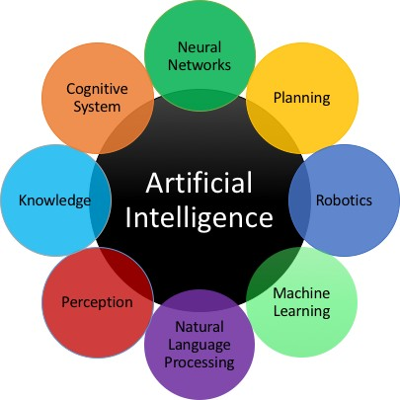
AI Topics
Artificial intelligence is a science and technology based on disciplines such as Computer Science, Biology, Psychology, Linguistics, Mathematics, and Engineering
Notes:
Knowledge Representation
Reasoning
Language
Learning
Perception
Problem Solving
Rules
Search

Slide 25
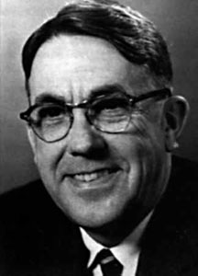
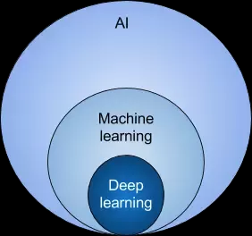
Our focus will be Machine Learning
In 1959, Arthur Samuel, MIT, defined machine learning as "the ability to learn without being explicitly programmed."
ML is based around the idea that we should really just be able to give machines access to data and let them learn for themselves

Slide 26
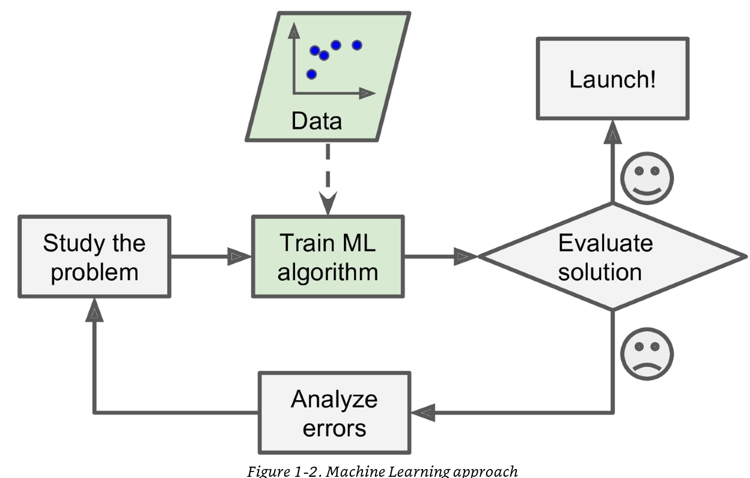
Machine Learning Approach
Notes:
Consider how might you develop a spam filter? What are the problems to maintain the rules manually? Would it not be great if a machine can adapt itself to detect spam automatically?

Slide 27
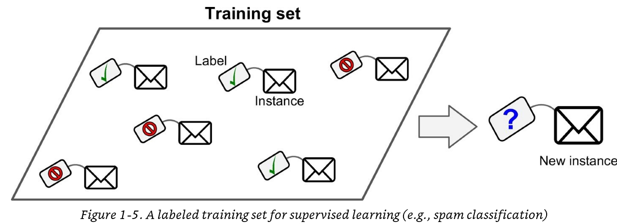
Supervised Learning
Supervised learning - Need a labelled training set to learn from

Slide 28
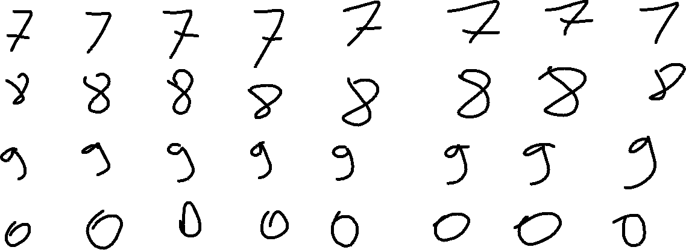
Handwriting Recognition
Supervised learning - a labelled training set where each handwritten char is a 28x28 image and the label is the corresponding digit

Slide 29
Supervised learning algorithms
K-Nearest Neighbours
Linear Regression
Logistic Regression
Support Vector Machines
Decision Trees and Random Forests
Naïve Bayes
Perceptron and Neural Networks

Slide 30
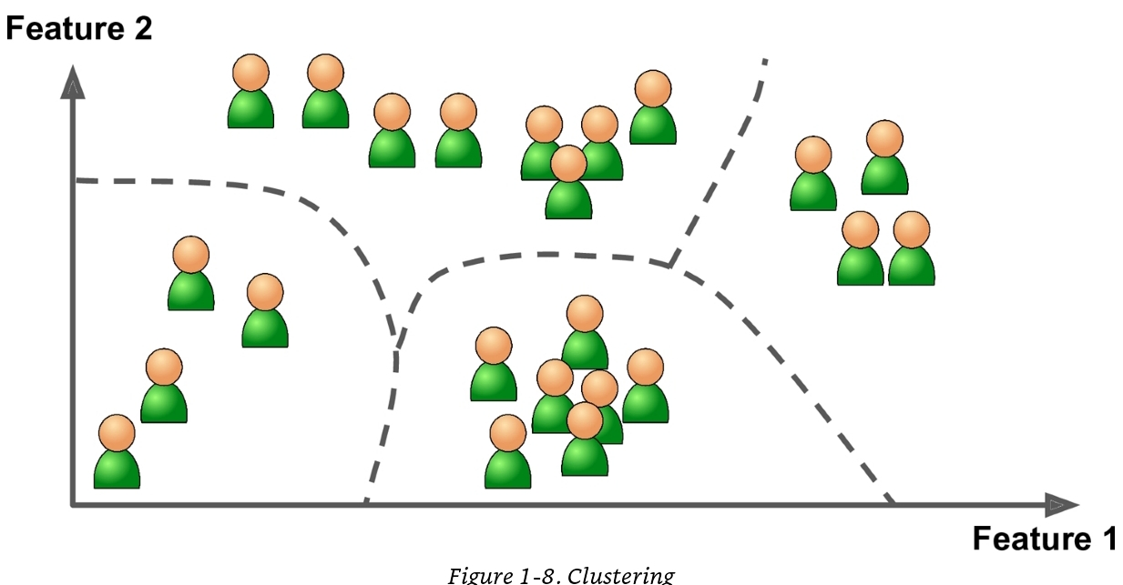
Unsupervised learning
No labelling required just the data with a view to discovering patterns e.g. common clusters

Slide 31
Unsupervised learning algorithms
Clustering
K-means
Hierarchical cluster analysis
Expectation maximisation
Visualisation and dimensionality reduction
Principal Component Analysis
Local linear embedding
Association Rule Learning

Slide 32
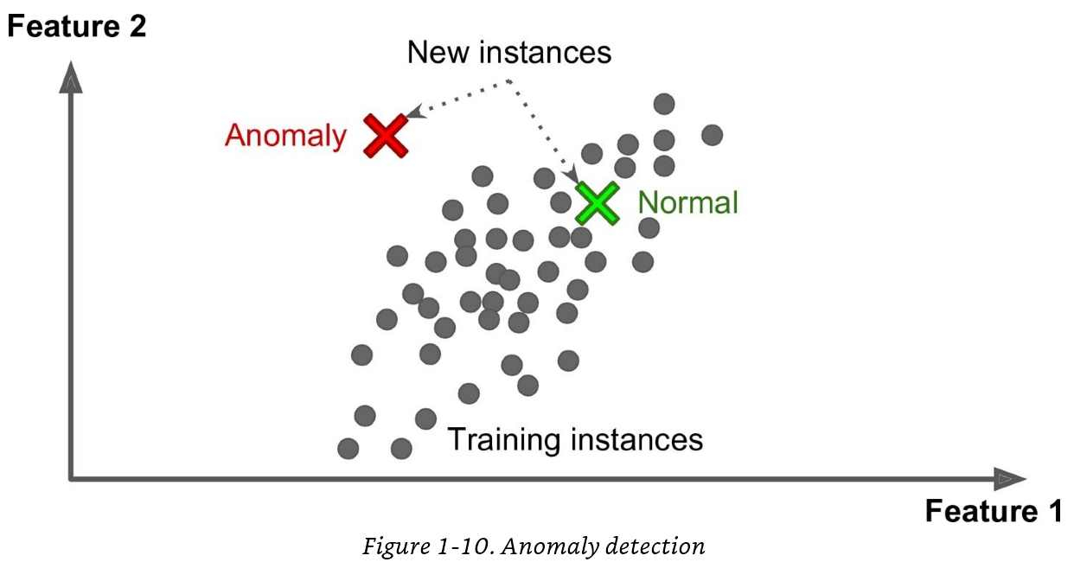
Unsupervised learning – anomaly detection

Slide 33
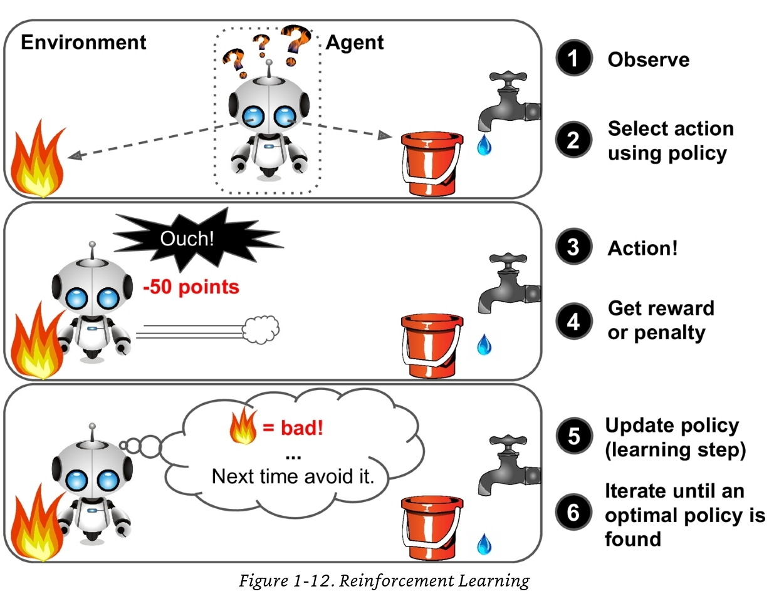
Reinforcement Learning
Notes:
Reinforcement learning involves an agent, who observes the environment, select and perform actions, and get rewards in return (or penalties in the form of negative rewards). It must learn by itself what is the best strategy, called a policy, to get the most reward over time.
A policy defines what action the agent should choose when it is in a given situation.
Many robots implement reinforcement learning algorithms to learn how to walk. DeepMind’s AlphaGo program is also a good example of reinforcement learning, it made the headlines in May 2017 when it beat the world champion (Ke Jie) at the game of Go.
It learned its winning policy by analysing millions of games, and then playing many games against itself.

Slide 34
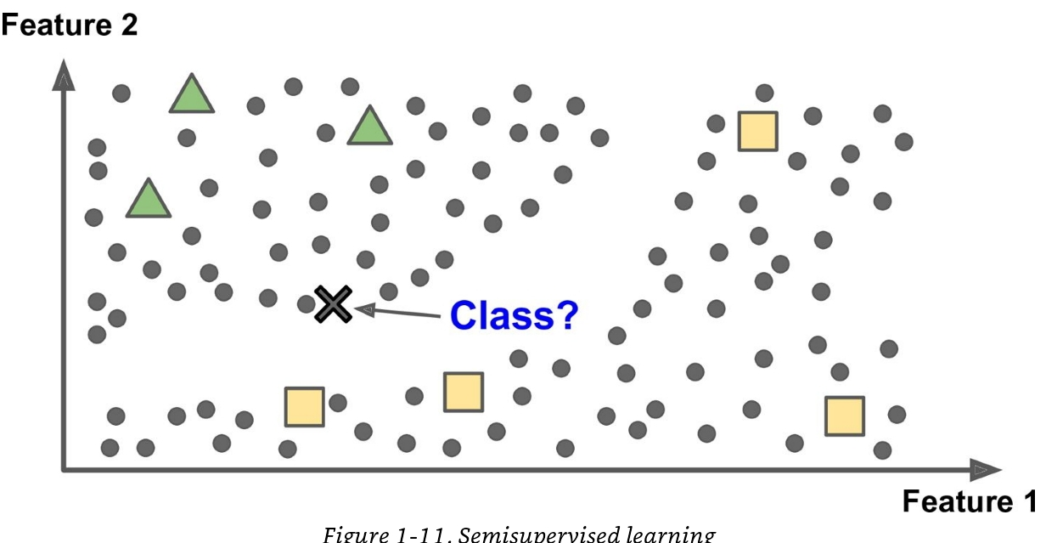
Semi-supervised learning
Notes:
Typical example is photo hosting systems like Google photos.
Once you upload loads of your family photos; the system uses unsupervised learning to identify similar faces.
Thereafter you need only label one of the faces in the set of similar faces.

Slide 35
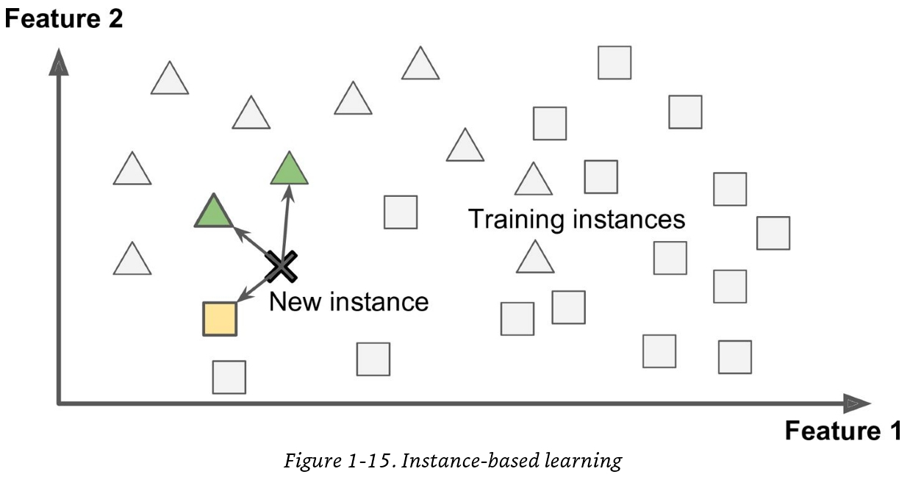
Lazy-learning versus model-based learning
Supervised learning where problem-solving is based on memorising instances and similarity computation.

Slide 36
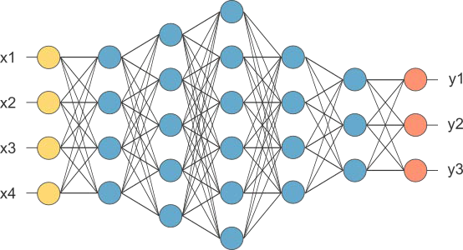
Lazy-learning versus model-based learning
(Image courtesy of OpenNN)
Supervised learning where a model is created as part of training

Slide 37
Challenges for machine learning
Insufficient quantity of training data
Non representative training data
Poor quality data
Irrelevant features
Overfitting and under fitting the training data

Slide 38
Conclusion
AI has inter-related scientific and engineering goals.
Roots in philosophy and neuroscience
Human behaviour: start by looking at human intelligence.
Try to model and copy human neural processing.
Importance of efficient knowledge representations.
Higher levels of abstraction: artificial intelligent agents.
Expert systems: build knowledge into agents.
Dealing appropriately with uncertain information.
Get AI machines to learn for themselves appropriately.
Sub-fields: Knowledge Representation, Search, Learning.
Research in AI: learning, reasoning, problem-solving.

Slide 39

Conclusion
The original question, “Can machines think?”, I believe
to be too meaningless to deserve discussion. Nevertheless
I believe that at the end of the century the use of words and
general educated opinion will have altered so much that one
will be able to speak of machines thinking without expecting
to be contradicted.
-Alan Turing (1950)

Slide 40
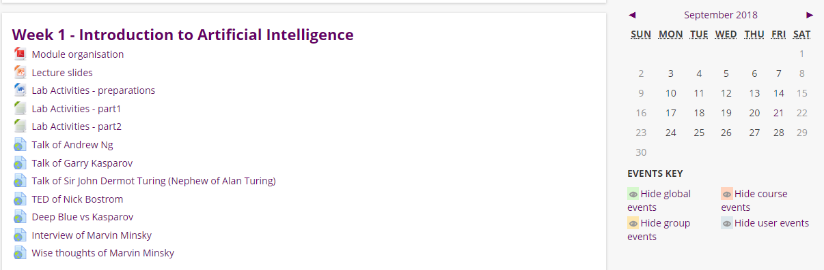
Lab Activities
Introduction to Python
How to use the Jupyter editor
Intro to Python constructs (variables, conditional statements, loops etc.)
Dig further into manipulating lists – important because you need to work with lots of data!

Slide 41
References
RUSSELL & NORVIG. Artificial Intelligence: A Modern Approach.
RASCHKA. Python Machine Learning. Packt
RASHID T, 2016, Make Your Own Neural Network, Create Space Publishing
GERON A, 2017, Hands-On Machine Learning with Scikit-Learn and TensorFlow
BISHOP C, 2006 , Pattern Recognition and Machine Learning, Springer
KOWALSKI R, 2011, Computational Logic and Human Thinking, Cambridge University Press.
ERTEL W, 2011, Introduction to Artificial Intelligence, Springer

